Slide 1

ME 200 Thermodynamics
Lecture 05 – Quality

Slide 2
p-v Diagram
A pure substance in the liquid state will be found in this region…
A.
D.
p
B.
C.
v

Slide 3
p-v Diagram
If the state of a substance lies on the line indicated, it is called a…
Subcooled liquid
Two-phase L+V
Saturated vapor
Saturated liquid
A.
D.
p
B.
C.
☆
v

Slide 4
p-v Diagram
If the state of a substance lies at the point indicated, which of the following is true?
There is more vapor than liquid.
There is more liquid than vapor
There are about equal amounts liquid and vapor.
Don’t know
p
☆
v

Slide 5
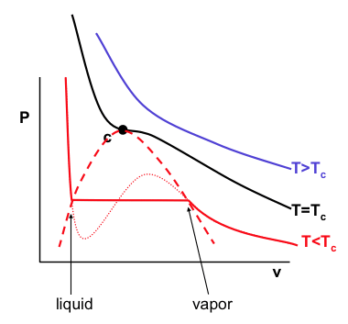
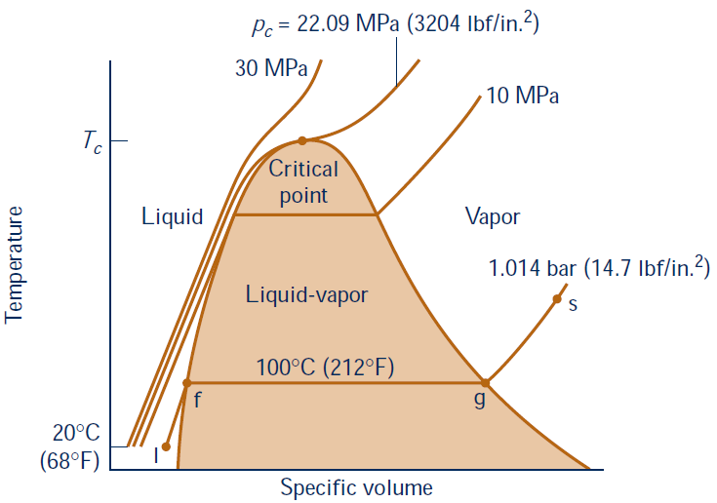

p-v Diagram
During phase changes, p & T
are not independent!
Define: Quality
$$pv=RT$$
liquid-vapor dome
2-phase

Slide 6


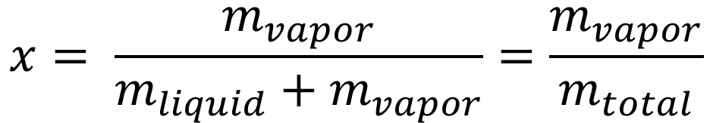
Quality
Define: Quality $x$ - Vapor mass ratio
$$x= \frac{m_{vapor}}{m_{liquid}+m_{vapor}}=\frac{m_{vapor}}{m_{total}}$$
$$x=0: v_{f},u_{f},h_{f} for saturated liquid$$
$$x=1: v_{g},u_{g},h_{g} for saturated vapor$$
f
x = 0
g
x = 1

Slide 7
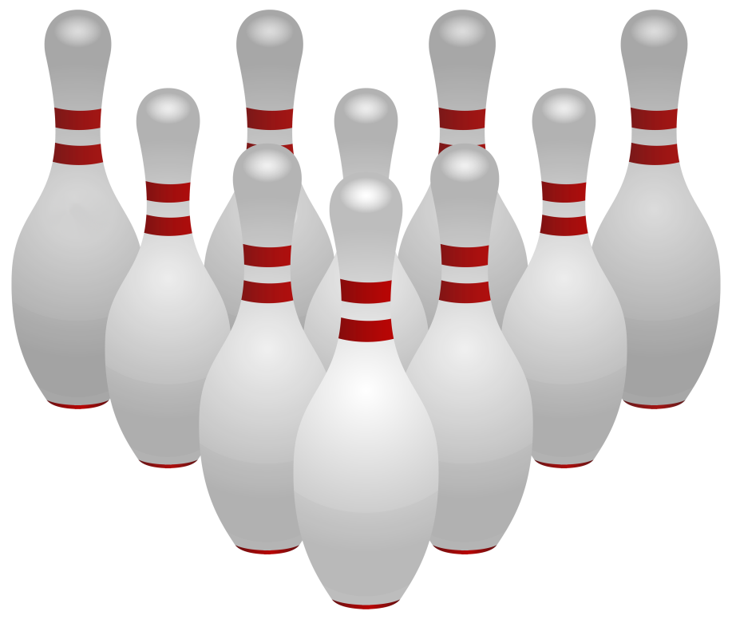
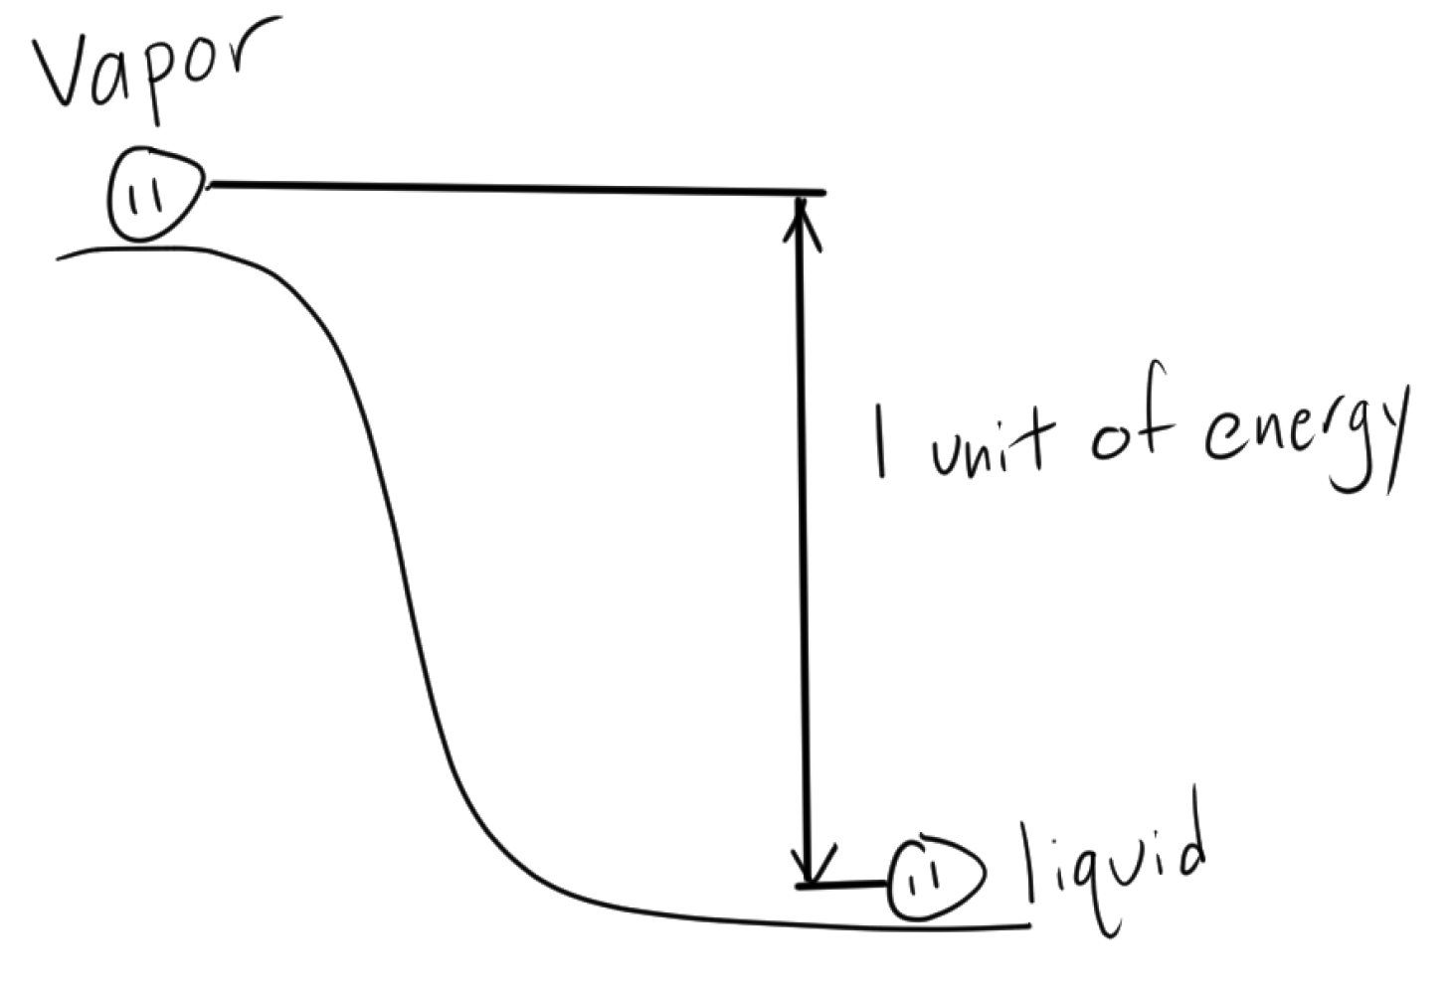
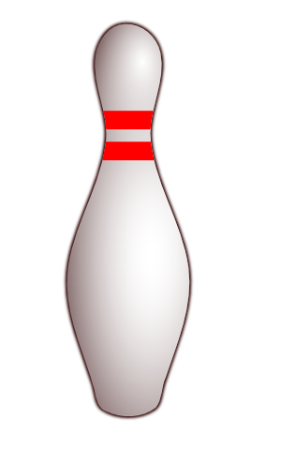
Quality
Bowling Pin Analogy to a Change of Phase
Latent heat of vaporization
PE
PE
liquid
vapor
Notes:
You are either liquid or either vapor, gravitation well. This is basically the latent heat of vaporization. So when we say x = 0.5 we are saying that one half is liquid and one half is vapor. This is a mass ratio. Not a volume ratio.

Slide 8


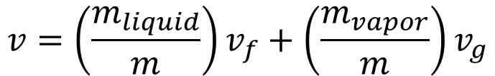

Property Calculation in Liquid-Vapor Dome
Bowling Pin Analogy to a Change of Phase
- Quality $x$ – vapor-mass fraction
$$v=\left(\frac{m_{liquid}}{m}\right)v_{f}+\left(\frac{m_{vapor}}{m}\right)v_{g}$$
$$v=\left(1−x\right)v_{f}+xv_{g}$$
$$=v_{f}+x(v_{g}−v_{f})$$
Can find u, h, s
liquid
vapor

Slide 9
A supercritical fluid is found in region?
A.
B.
D.
p
C.
v

Slide 10
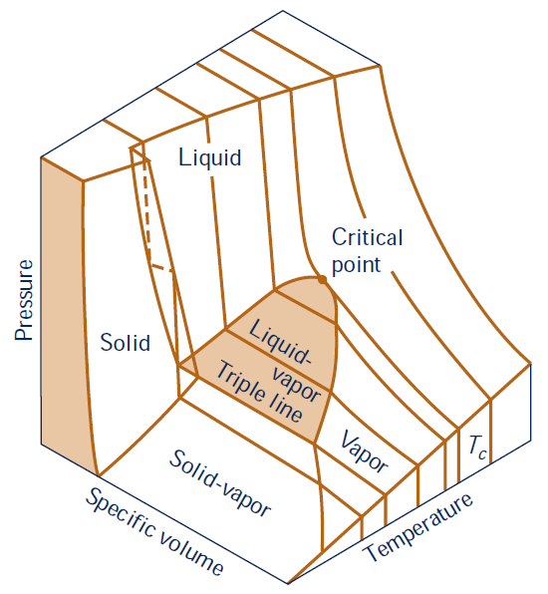
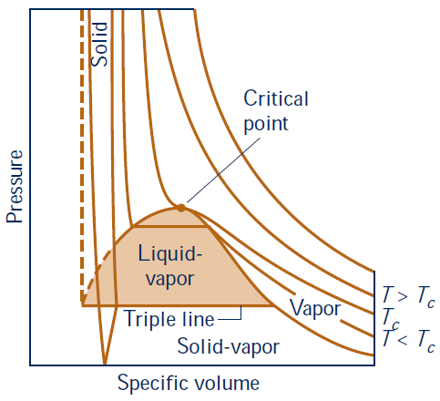
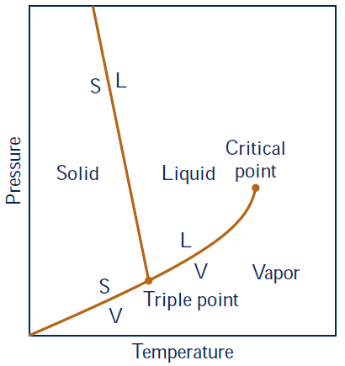
Solid Phase Change
p–v–T surface and projections for a substance that
expands on freezing
Main example: Water – reason for pipe breakage
Notes:
Difference is with water and some other fluids. Pressure decrease, temperature freezing increase?! High mountains (low P) freezing temp go higher! That’s why we see snow! Temperature go down, pressure INCREASES and VOLUME INCREASE! Ice important for life!

Slide 11
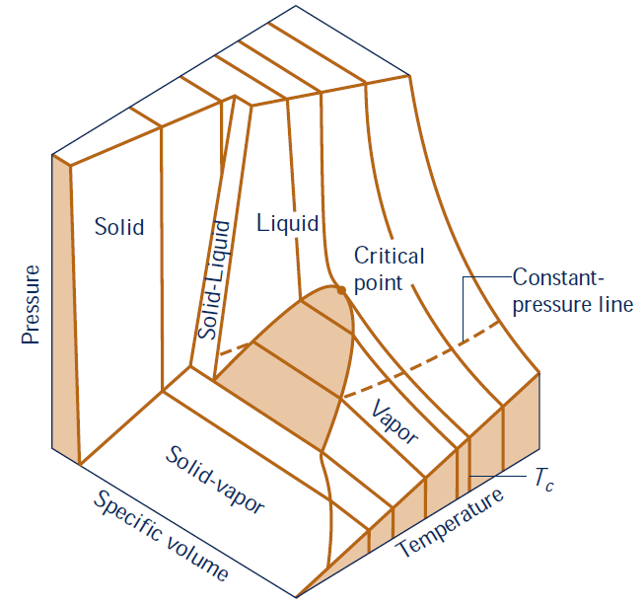
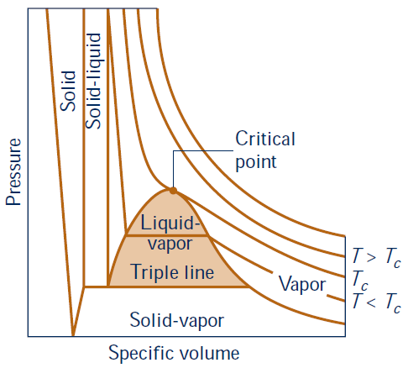
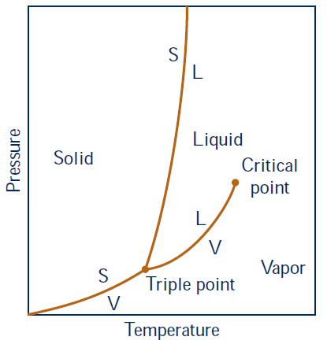
Solid Phase Change
p–v–T surface and projections for a substance that
contracts on freezing
Notes:
Two types, contract on freezingPhase change from solid liquid there is also a phase change. P-T diagram is the interfaces. Most of these substances are like this.

Slide 12
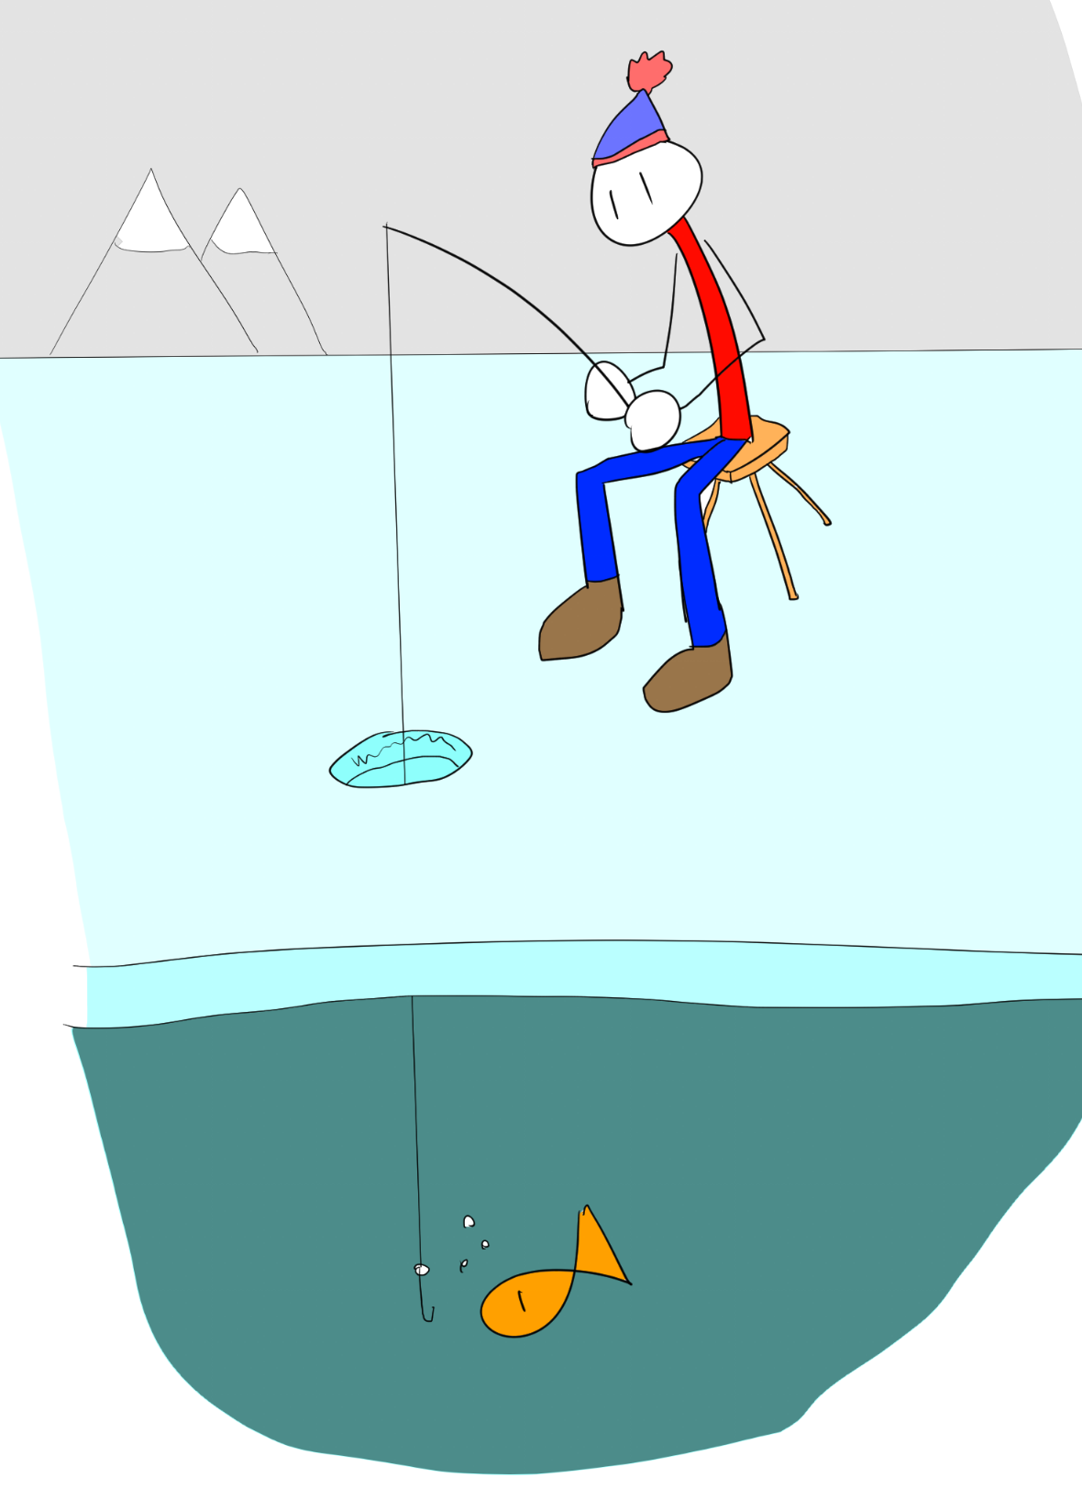
Ice Fishing
Why is this important for life?

Slide 13
Locate a point at high p, low T
B.
A.
D.
C.

Slide 14
Where can the liquid-vapor dome be found?
B.
A.
liquid-vapor dome
C.
D.

Slide 15
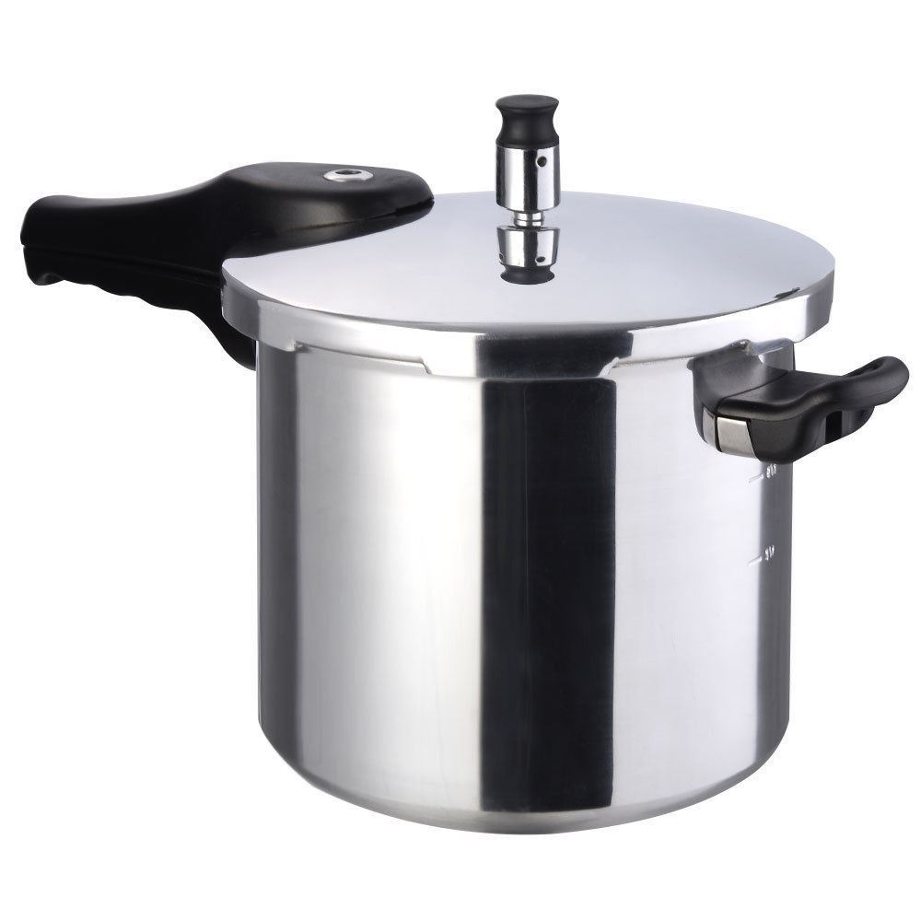
Pressure Cooker
What controls the cooking pressure?
Notes:
Usual, water gets boiled out and your food burns. Seal it to get higher pressure, changing to a higher scale, higher pressure and higher temperature and cook faster.
What controls pressure cooker?

